Slide 1
Unit4
TABLES & FRAMES

Slide 2
HTML Tables
An HTML table is defined with the <table> tag.
Each table row is defined with the <tr> tag.
A table header is defined with the <th> tag.
By default, table headings are bold and centered.
A table data/cell is defined with the <td> tag.

Slide 3
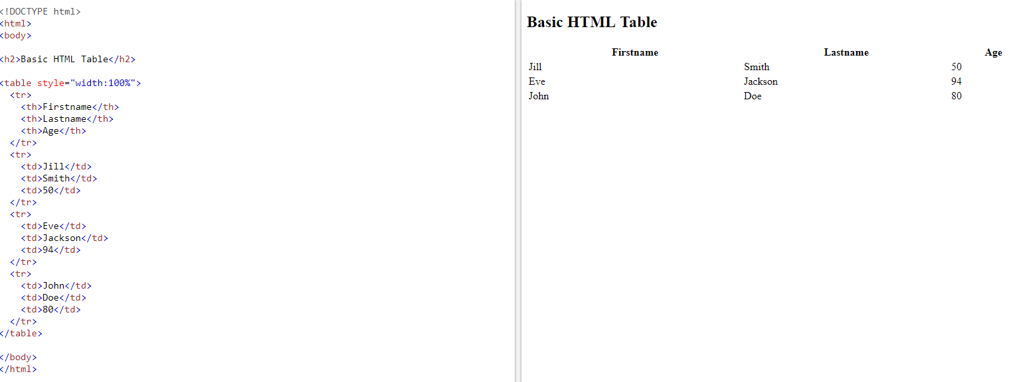

Slide 4
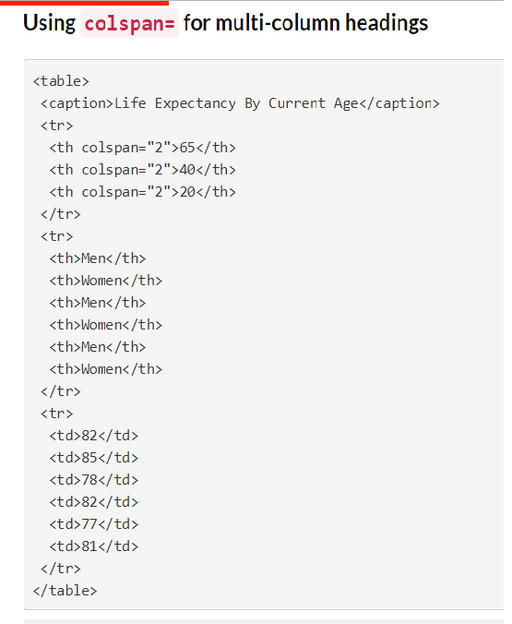
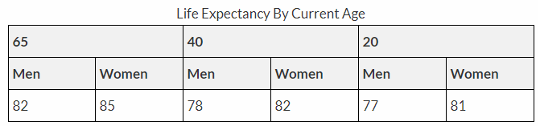
Cells that Span Many Columns
To make a cell span more than one column, use the colspan attribute:

Slide 5
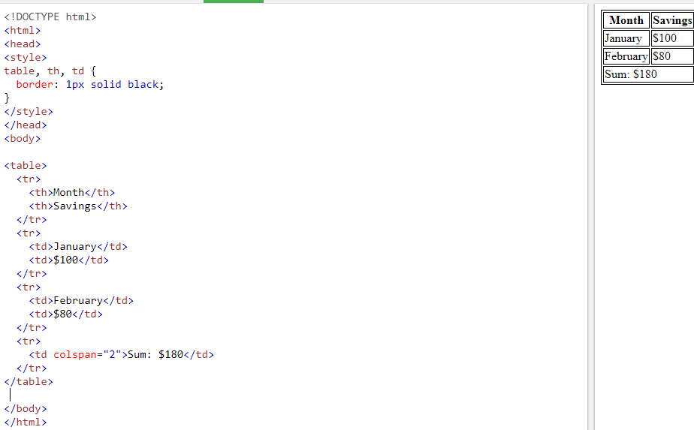

Slide 6
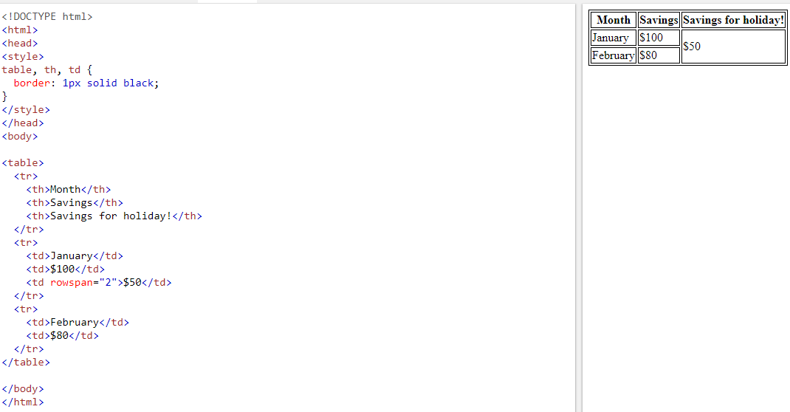
HTML <td> rowspan Attribute
The rowspan attribute specifies the number of rows a cell should span.

Slide 7
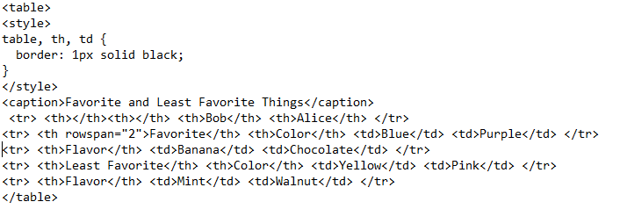
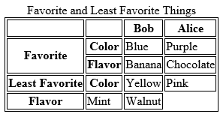

Slide 8
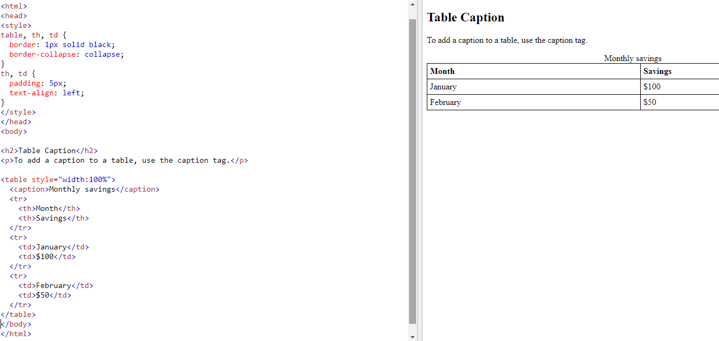
Adding a Caption

Slide 9
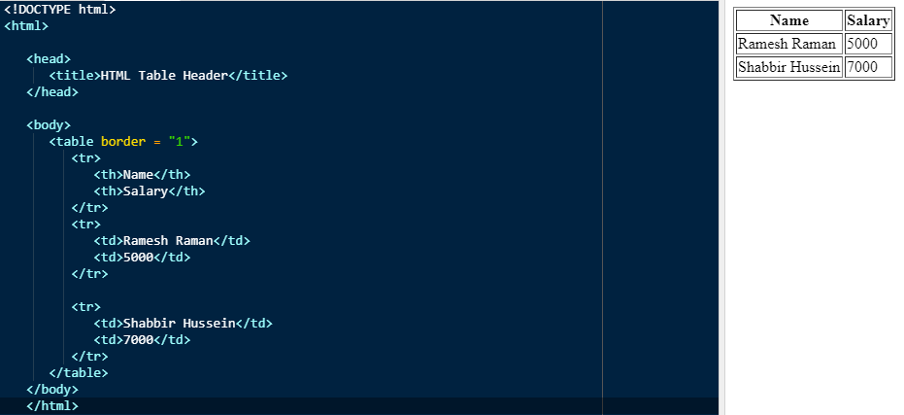
Here, the border is an attribute of <table> tag and it is used to put a border across all the cells. If we do not need a border, then we can use border = "0".

Slide 10
Cellpadding and Cellspacing Attributes
There are two attributes called cellpadding and cellspacing which we will use to adjust the white space in your table cells.
The cellspacing attribute defines space between table cells
cellpadding represents the distance between cell borders and the content within a cell.

Slide 11
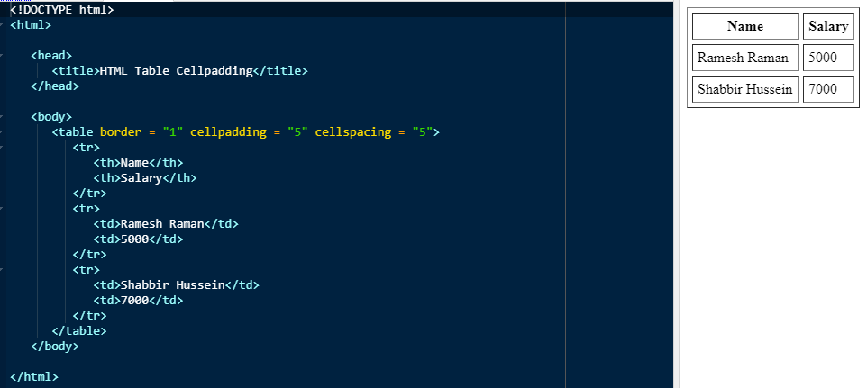

Slide 12
Colspan and Rowspan Attributes
We will use colspan attribute if we want to merge two or more columns into a single column.
we will use rowspan if we want to merge two or more rows.

Slide 13
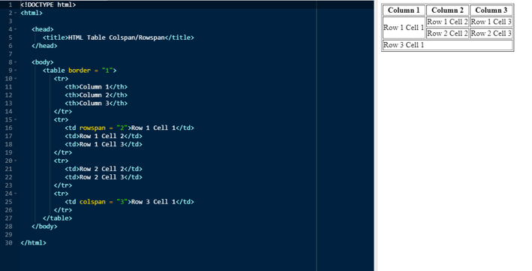

Slide 14
Tables Backgrounds
we can set table background using one of the following two ways −
bgcolor attribute − we can set background color for whole table or just for one cell.
background attribute − we can set background image for whole table or just for one cell.
we can also set border color also using bordercolor attribute.

Slide 15
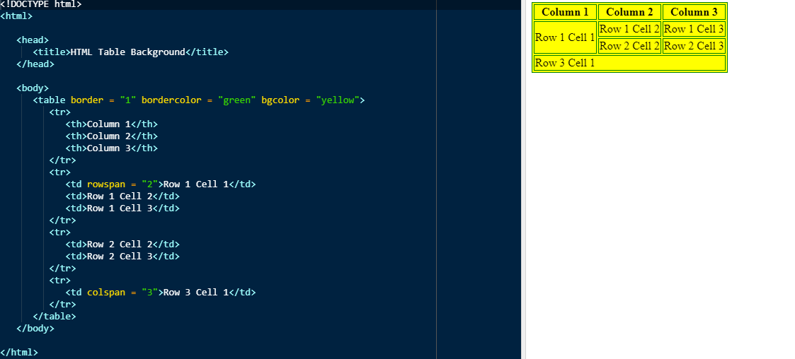

Slide 16
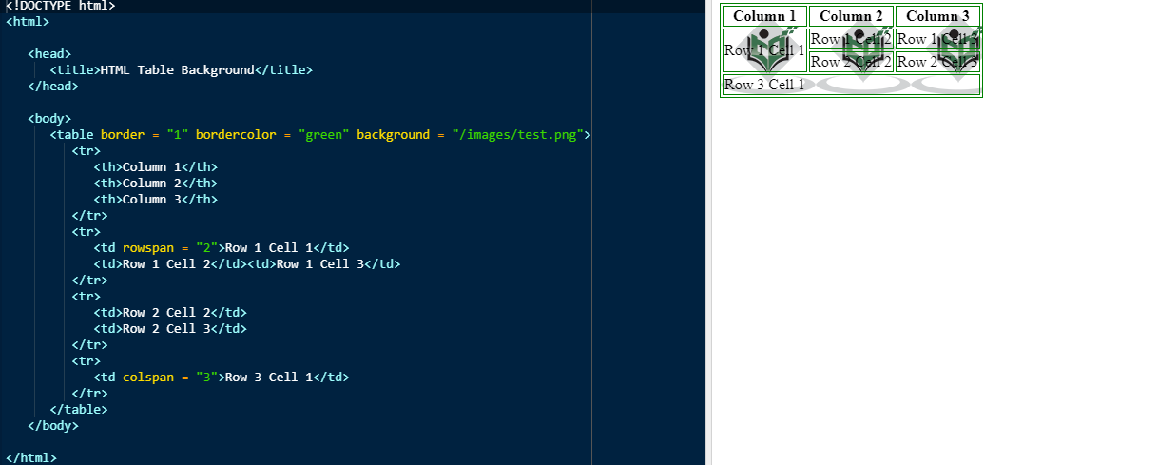

Slide 17
Table Height and Width
we can set a table width and height using width and height attributes.
we can specify table width or height in terms of pixels or in terms of percentage of available screen area.

Slide 18
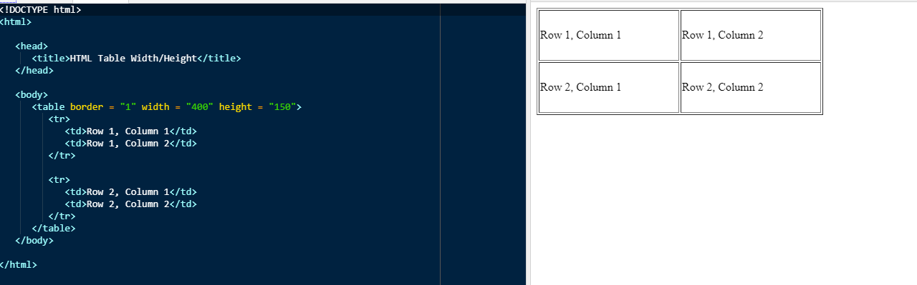

Slide 19
Table Header, Body, and Footer
Tables can be divided into three portions − a header, a body, and a foot. The head and foot are rather similar to headers and footers in a word-processed document that remain the same for every page, while the body is the main content holder of the table.

Slide 20
The three elements for separating the head, body, and foot of a table are −
<thead> − to create a separate table header.
<tbody> − to indicate the main body of the table.
<tfoot> − to create a separate table footer.
A table may contain several <tbody> elements to indicate different pages or groups of data.
<thead> and <tfoot> tags should appear before <tbody>

Slide 21
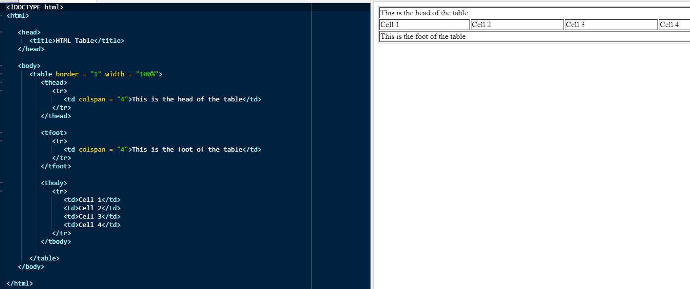

Slide 22
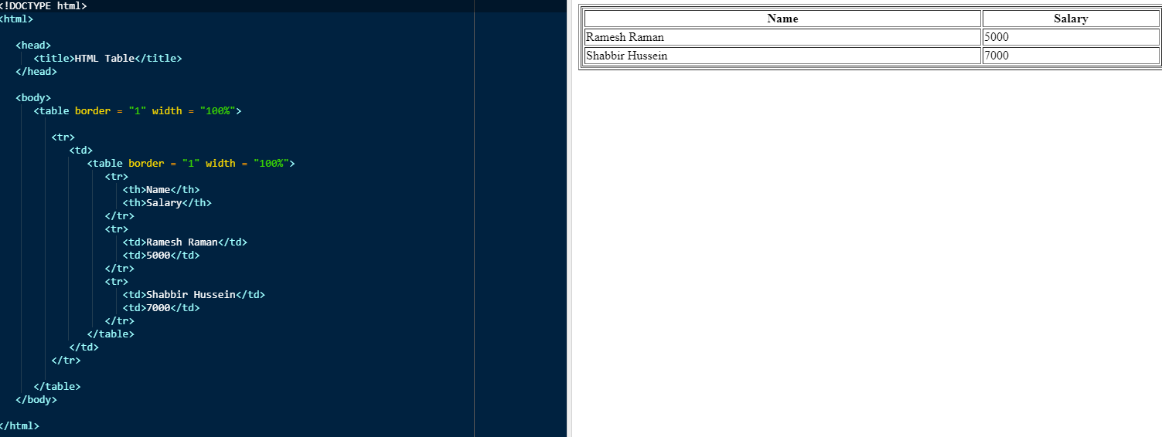
Nested Tables
we can use one table inside another table.

